Slide 1
Arden Medical centre
Patient Satisfaction 2016

Slide 2
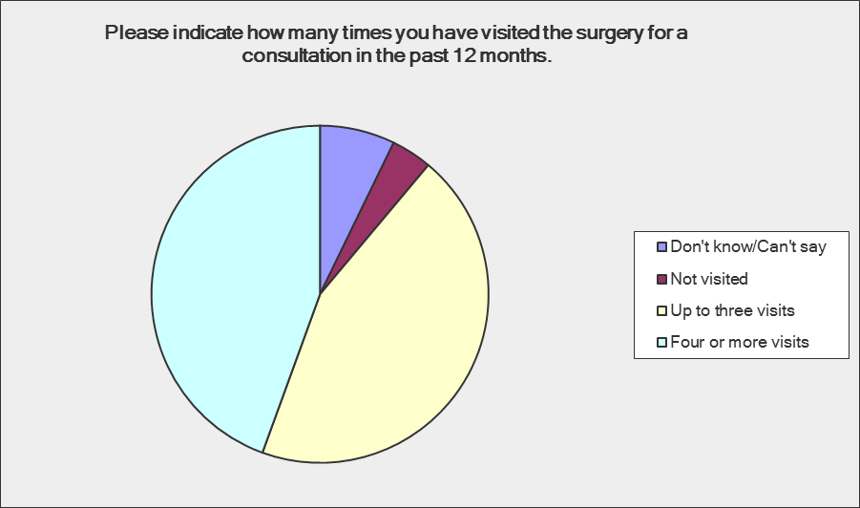
Surgery Visits
44%
44%

Slide 3
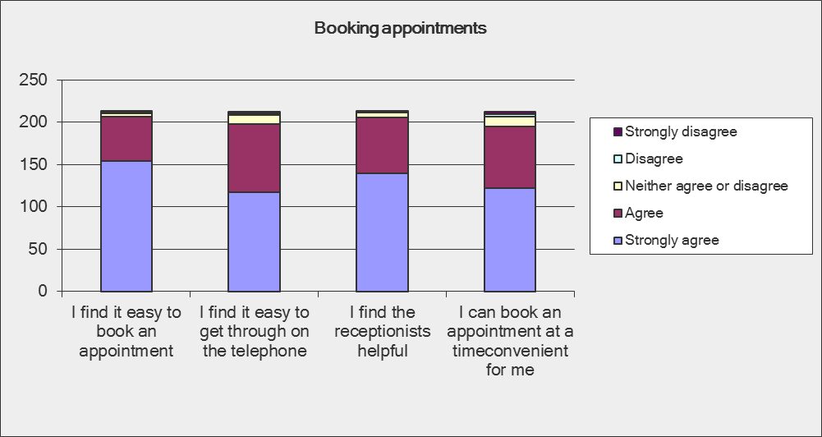
Booking appointments
72%
55%
66%
58%

Slide 4
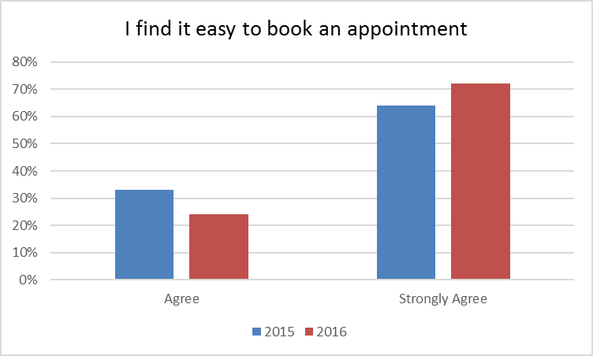
Booking appointments

Slide 5
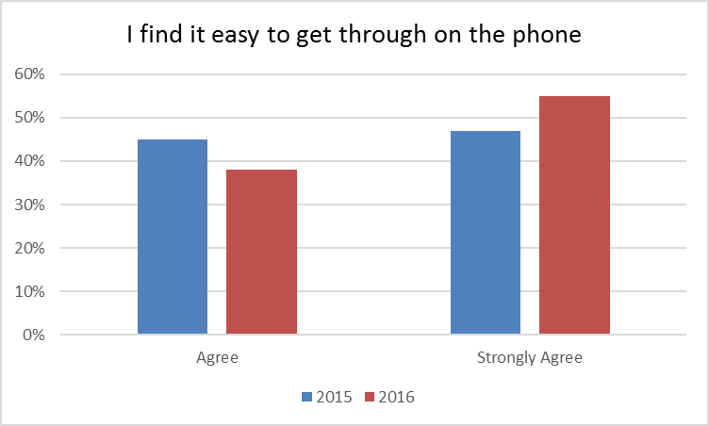
Telephone access

Slide 6
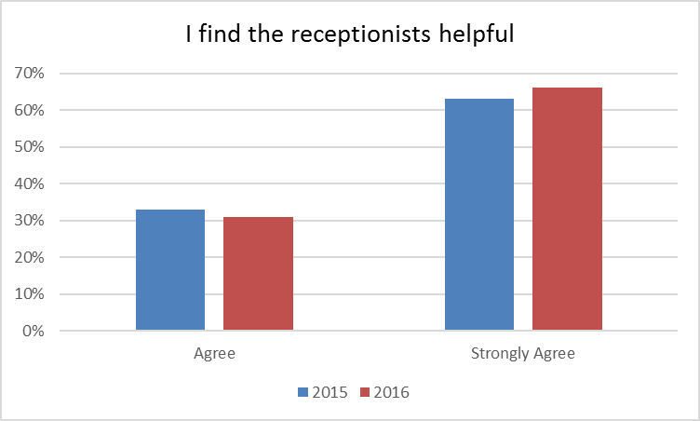
receptionists

Slide 7
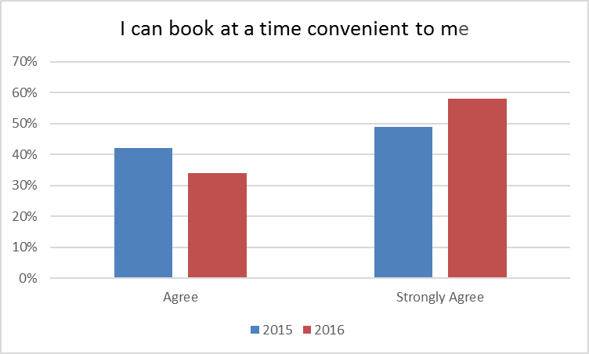
Booking convenience

Slide 8
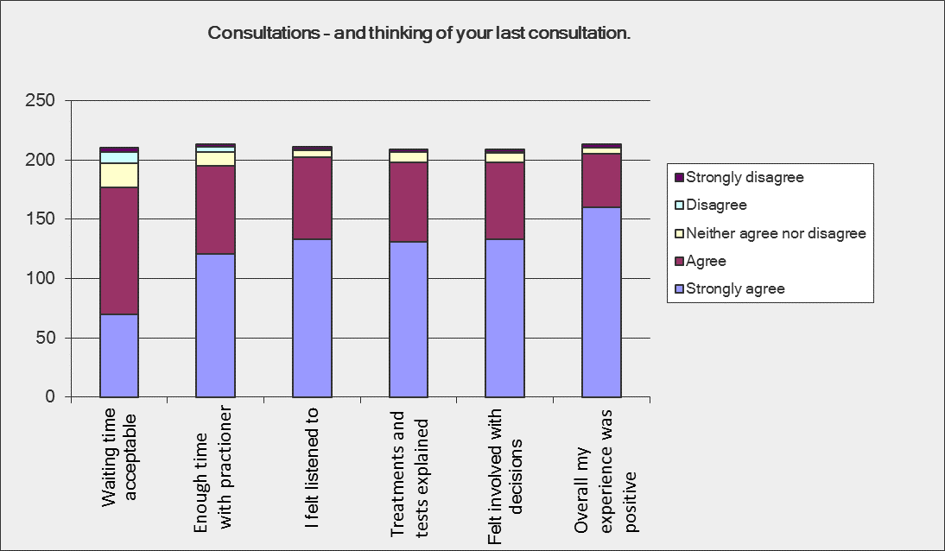
Consultations
21%
33%
32%
31%
35%
51%
63%
63%
64%
75%
57%
33%

Slide 9
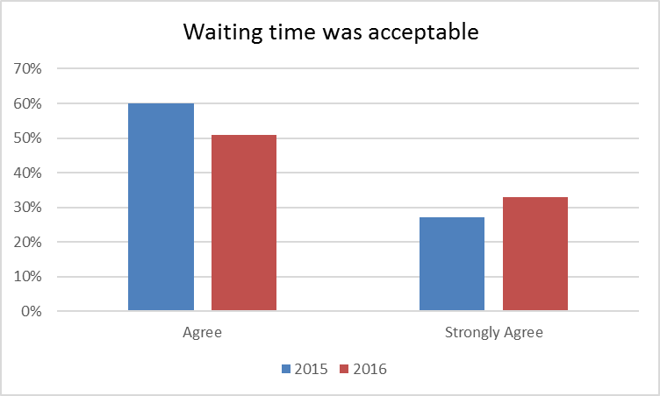
Waiting Time

Slide 10
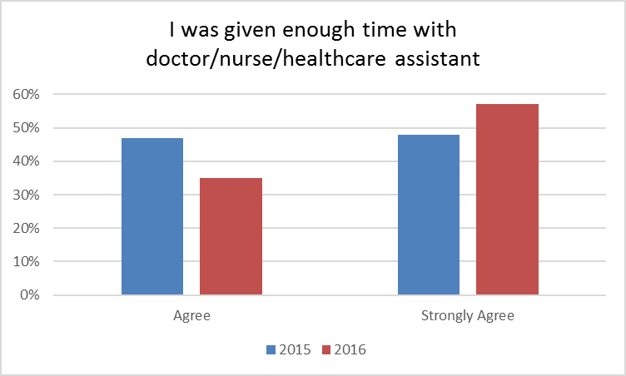
I was given enough time

Slide 11
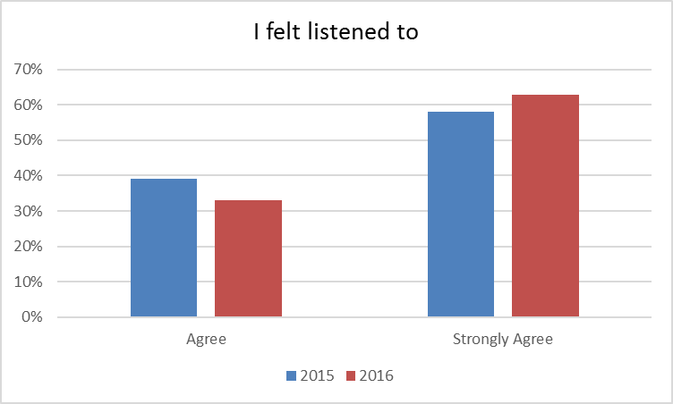
I felt listened to

Slide 12
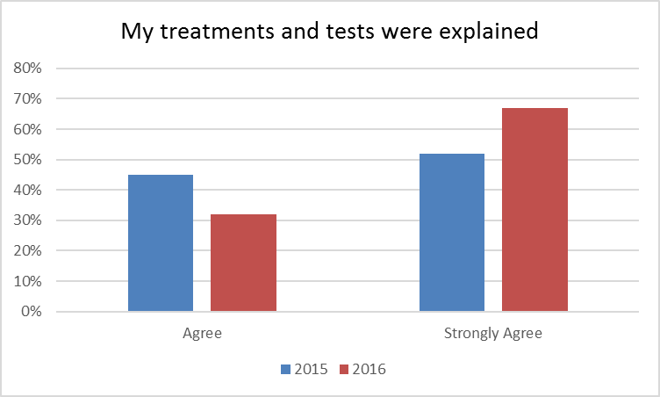
My treatment and tests were explained to me

Slide 13
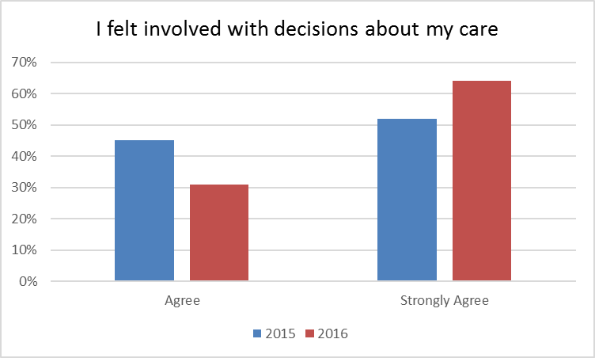
Involved in decisions

Slide 14
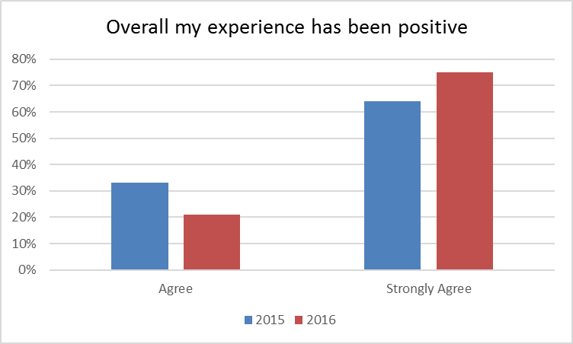
Overall my experience at amc has been positive

Slide 15
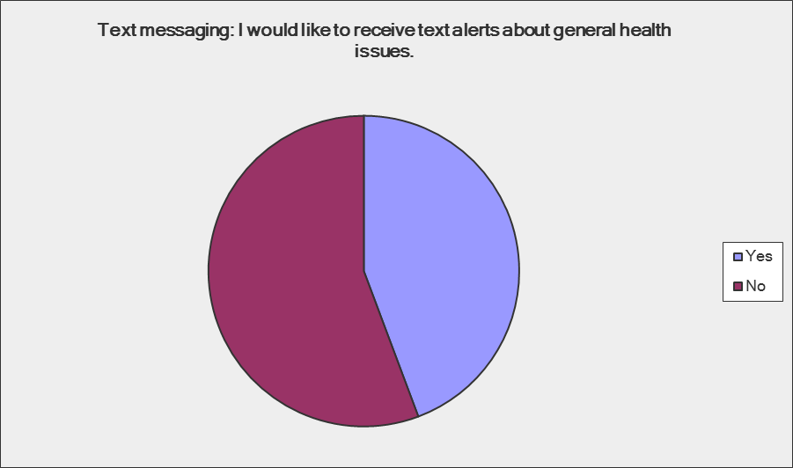
Text messaging
44%
56%

Slide 16
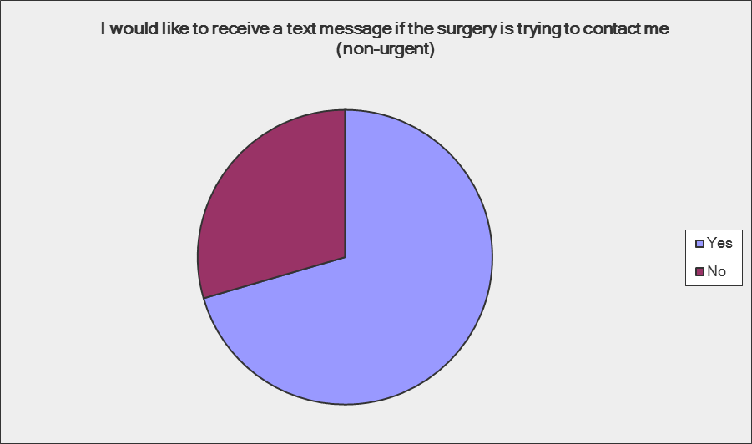
Text messaging
29%
71%

Slide 17
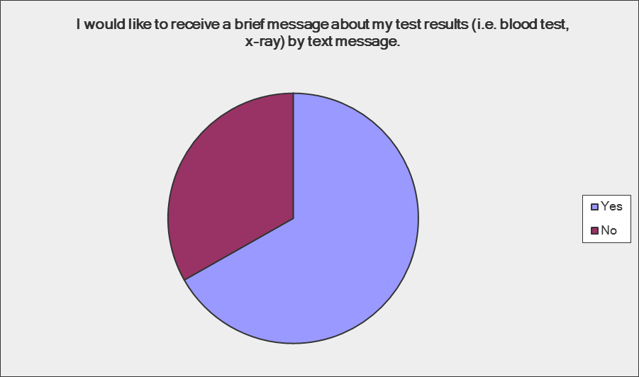
Text messaging
33%
67%

Slide 18
Verbatim comments
I have been with the surgery since 1990 & have been & still are delighted at all times.
Thank you so much
I think antibiotics should be carefully monitored
I work in Birmingham so find it hard sometimes to pre-book late appointments.
Often am told to call on day.
Excellent service
Very helpful and friendly
Had no problems with appointments, always helpful.
Don't change anything!
Very good service
We moved from another surgery - to receive better service and we have!
I do not use a computer or smart phone
Should open Wed pm - why do you close!

Slide 19
Verbatim comments
Improve, review your letter, they cost money to send and are sent unnecessarily.
I have been to my appointment, but still get letters to go! Waste of money to send.
Brilliant service - thank you
Brilliant service
Thanks for the service you all provide
I find my experience here (compared to others I hear about from other GP practices
extremely positive. Thank you!
I find the whole experience very helpful. The best surgery and doctors!
We really appreciate all support given to us
Great surgery staff
Great service

Slide 20
Verbatim comments
I am extremely impressed with all aspects of Arden Medical Centre
Waiting time at surgery can sometimes be horrendous, however having been
the cause of others having to wait, I know it is unavoidable at times. If patients are
made to wait it is usually because someone else is having a terrible time!
Maybe health promotional talks
Very satisfied with everything
Happy
More weekend / evening hours
6 day a week surgery including Weds pm
So far I have had good care from the practice. Can't think of anything more you can do
I feel very lucky to be a patient at this surgery. Press & friends confirm this!

Slide 21
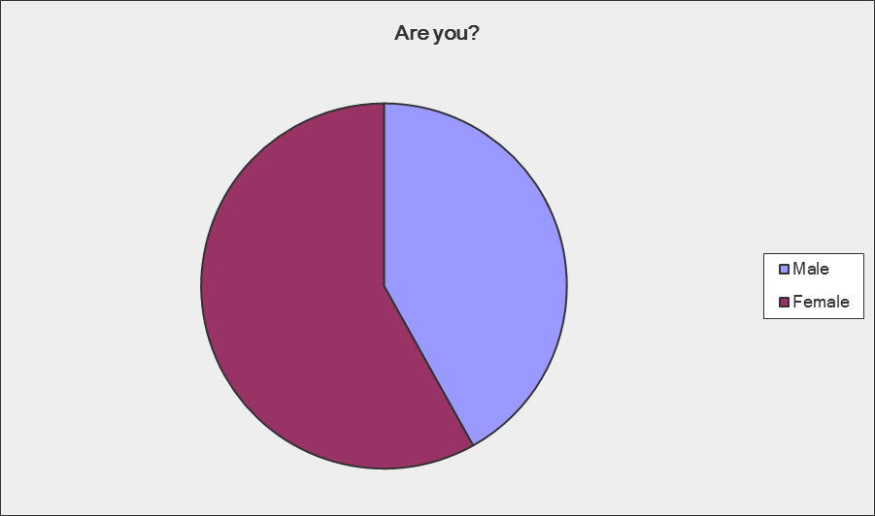
demographics
58%
42%

Slide 22
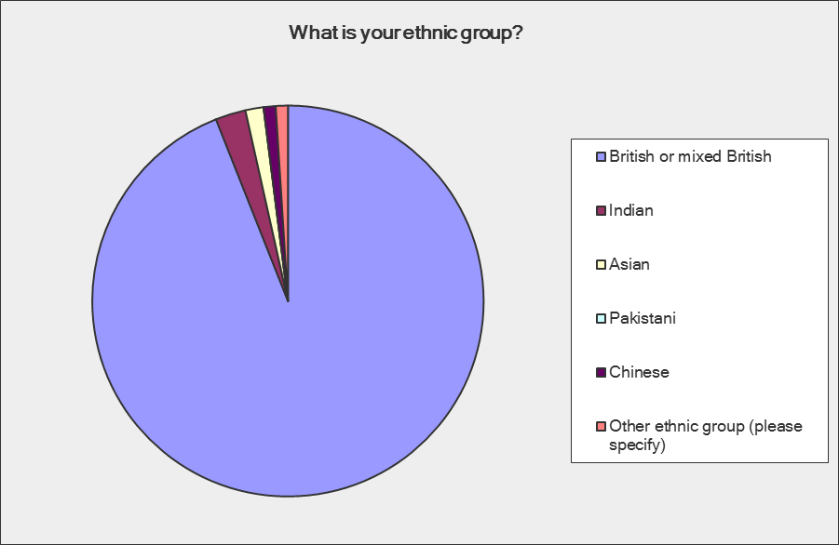
demographics
94%

Slide 23
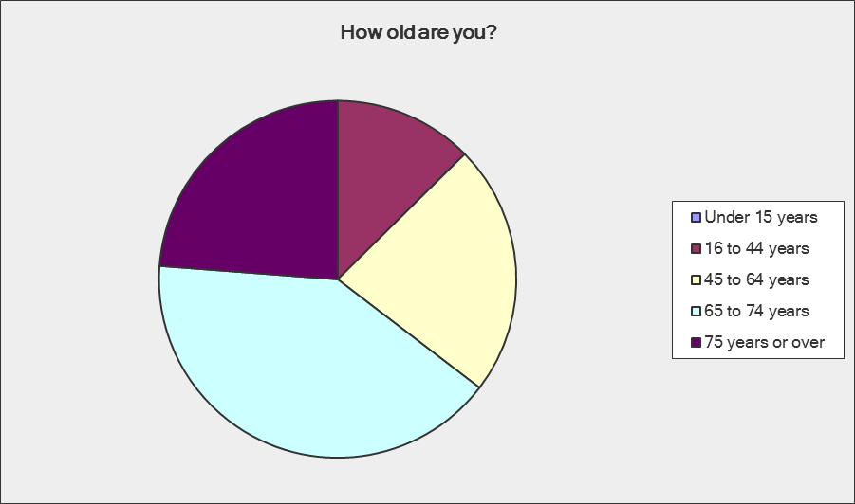
demographics
13%
24%
23%
41%

Slide 24
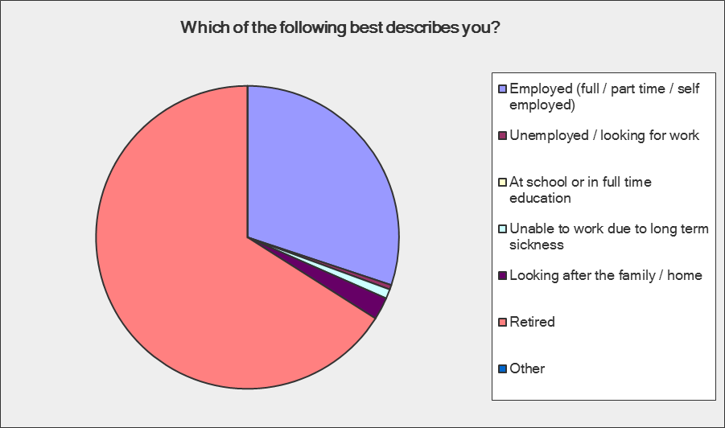
demographics
30%
66%

