Slide 1
1
Single Point of Access (SPA)
Maternity Care referral portal

Slide 2
2
National Drivers
National Review of Maternity Services – Better Births - providing choice and timely access to maternity care
NHS Long Term Plan:
By 2023/24, all women will be able to access their maternity notes and information through their smart phones or other devices.

Slide 3
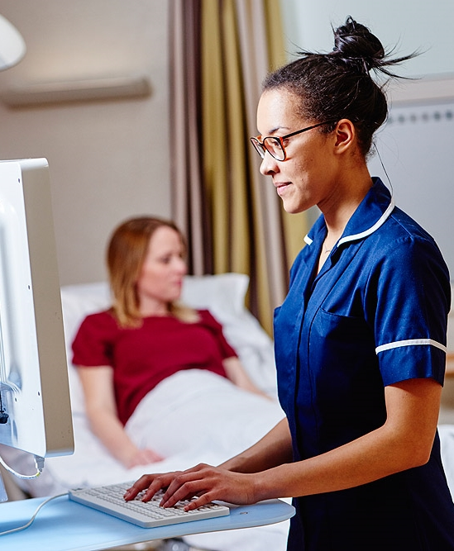
3
Principles
The NHS is shifting to self-referral as our primary means in to care
Providing women a option to self-refer with digital technology (self referral online portal)
A standard set of clinical questions to support streaming of women’s care to the right services
Midwifery led first contact to discuss all aspects of choice
All information, from point of self-referral processed in BadgerNet (Maternity Clinical System); since 2019 having a live single maternity record across Birmingham and Solihull LMNS trusts.

Slide 4
Benefits for GPs
Better access to information for GPs
Reduces use of paper to complete referral forms or sending letters in post
Reduces administration processes
GP can use portal to refer women thus reducing time to refer
Maternity staff working closer with GP practices
An electronic notification to GPs as soon as a woman is referred
Reducing need for GP appointment for maternity referral as instructions can be provided on practice website by receptionist
Portal is secure and simple to follow

Slide 5
The SPA Model
An Online Referral Portal
Referral completed by women (self-refer)
Collects basic info, and provides links to useful information
Dependent on existing medical conditions, will direct referral to specialist for shared care
A midwifery led SPA
Rapid contact with a midwife trained to handle choice questions ( hospital delivery or homebirth option), provide advice and guidance and carry out risk assessment all in a timely manner
Supported referral function
If woman has a language barrier or has no digital device, the referral can be completed and submitted on the woman’s behalf by the GP, admin staff or family member/ friends with her consent.
Next few slides provides screenshots of the SPA portal

Slide 6
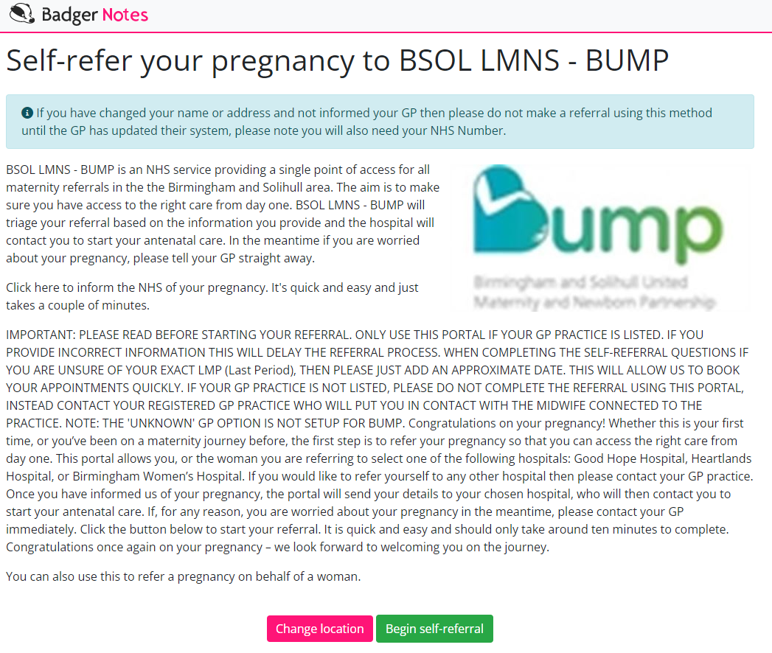
6
Screenshot of the SINGLE POINT OF ACCESS (SPA) PORTAL - Intro page

Slide 7
7
SINGLE POINT OF ACCESS (SPA) PORTAL – STEP 1

Slide 8
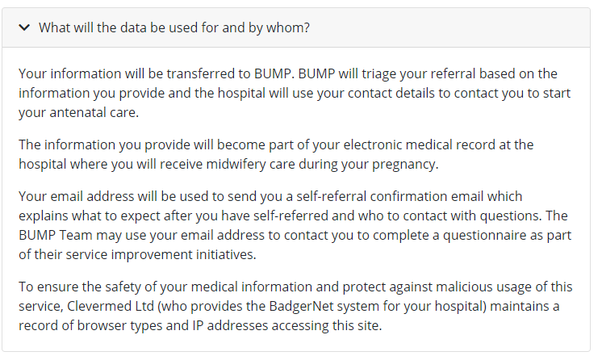
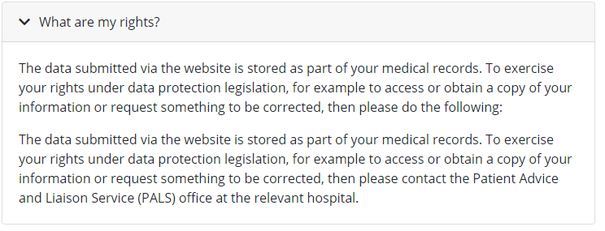
8
SINGLE POINT OF ACCESS (SPA) PORTAL Step 1 - Consent screen details

Slide 9
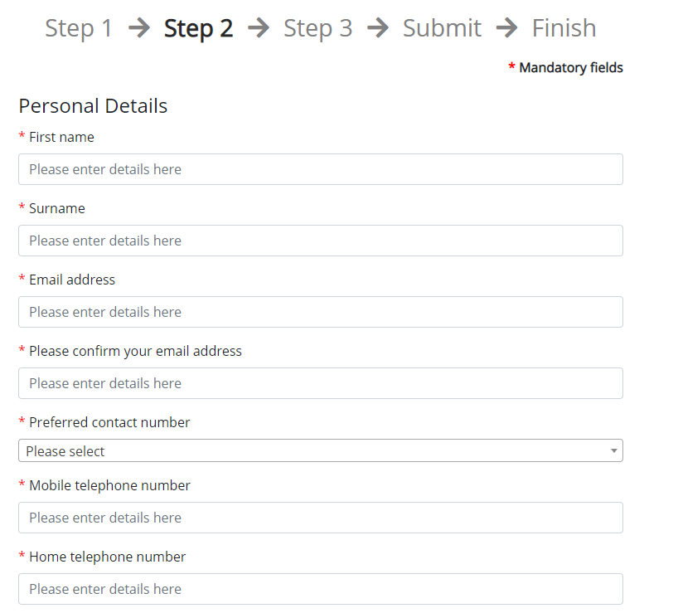
9
SINGLE POINT OF ACCESS (SPA) PORTAL STEP 2 – Entering personal details
The women is asked to complete her own details or can be supported by a healthcare professional or family member.
* All mandatory fields, need to be completed to proceed further with referral

Slide 10
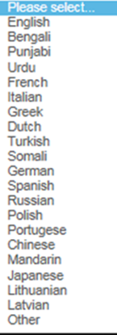
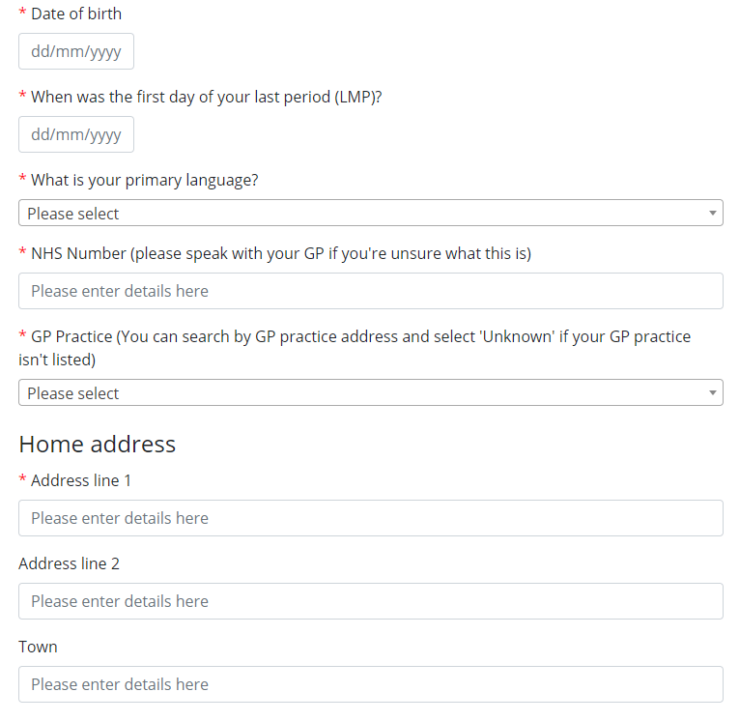
10
SINGLE POINT OF ACCESS (SPA) PORTAL STEP 2 – Entering personal details cont’d
Important that the correct NHS number is entered to avoid delays in processing
If requires an interpreter select language choice
Important that the right GP practice site is selected to reduce any delays in processing referral

Slide 11
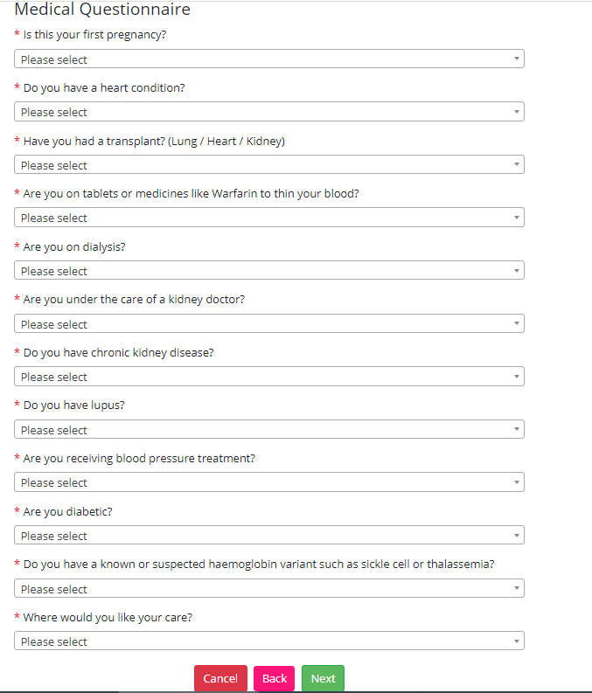
11
SINGLE POINT OF ACCESS (SPA) PORTAL STEP 3 - Health questions
The women will be asked to answer some medical questions,.
Allowing a fast-track referral to the hospital of her choice., highlighting the care pathway she needs dependant on the answers she provides.
Choice of Hospital sites to select from, asking for 1st, 2nd, 3rd choice – this has been included to manage capacity amongst Birmingham trusts

Slide 12
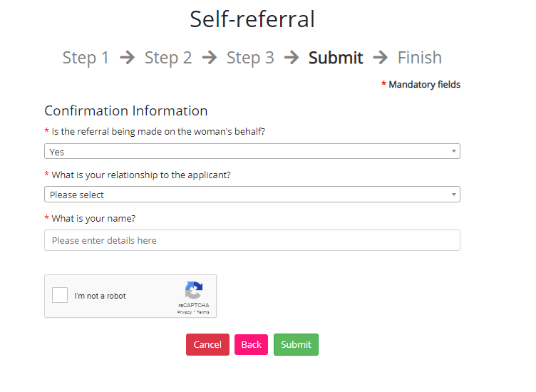
12
SINGLE POINT OF ACCESS (SPA) PORTAL – Submit screen
Relationship and name must be entered if someone is making referral on behalf of the woman
An email confirmation will be sent to the woman confirming her referral has been submitted

Slide 13
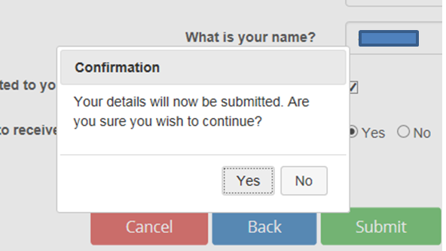
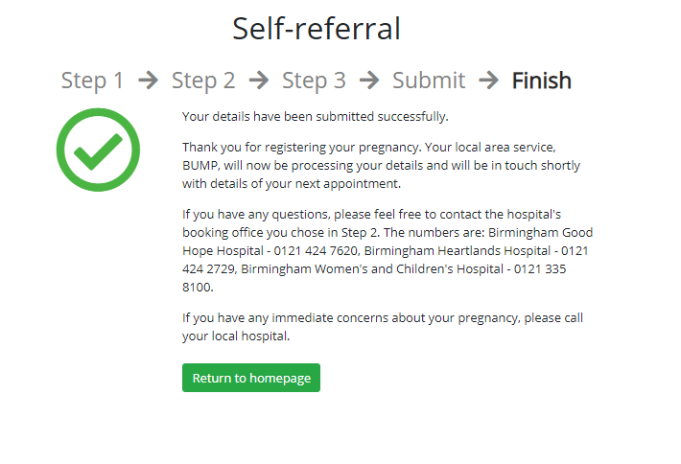
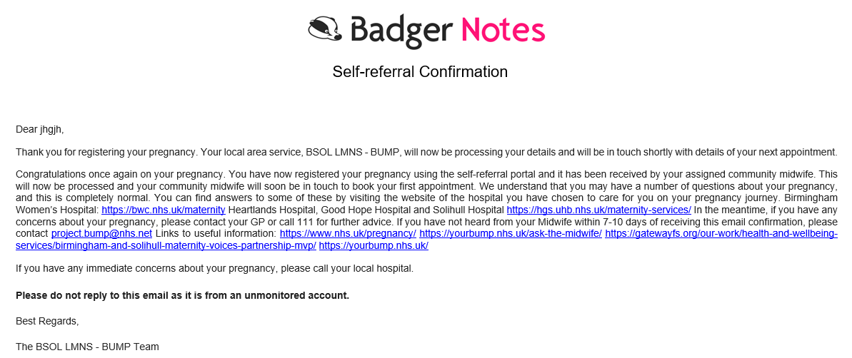
13
SINGLE POINT OF ACCESS (SPA) PORTAL – Referral submitted confirmation
Alert to confirm referral submission
Once ‘Yes’ is clicked, subsequent page to show successful submission of referral
Confirmation email sent to patient following completion of referral

Slide 14
14
SINGLE POINT OF ACCESS (SPA) PORTAL – Hospital Referral administration
The SPA referral portal is configured to automatically send email notifications to include a PDF copy of the completed referral form to the following:
To the appropriate booking office based on the woman’s 1st choice of hospital where she wants to give birth and have her care.
The community midwifery team assigned to the GP practice
The GP Practice generic email account
The booking office will then create a Maternity Care Record based on information provided in the referral and will align the woman to a care pathway depending on her level of risk.

Slide 15
15
SINGLE POINT OF ACCESS (SPA) PORTAL – Current pilot sites
Current Status: The following 19 practices have been piloting the Maternity SPA referral portal:
Surgery Name: | Practice Address:
Griffins Brook Medical Centre | Griffins Brook Medical Centre B30 1QN
Riverbrook Medical Centre | 3 River Brook Drive, Birmingham B30 2SH
Yardley Wood Health Centre | 401 Highfield Road, Birmingham B14 4DU
Bunbury Road Surgery | 108 Bunbury Road, Northfield, Birmingham, B31 2DN
West Heath Surgery | 194-196 West Heath Road, Birmingham B31 3HB
Hollymoor Medical Centre | Manor Park Grove, Birmingham B31 5ER
The Khattak Memorial Surgery | 309 Bolton Rd, Birmingham B10 0UA
Yardley Green Medical Centre | 77 Yardley Green Road, Birmingham B9 5PU
OMNIA Practice | 73 Yardley Green Road, Birmingham B9 5PU
FirstCare Practice | Balsall Heath Health Centre, B12 9LP
Dr El Sheikh- Strensham Road Surgery | Strensham Road Surgery, 4 Strensham Road, Birmingham B12 9RR
Sutton Coldfield Group Practice (Leyhill Surgery) | 228 Lichfield Road, Sutton Coldfield B74 2UE
Sutton Coldfield Group Practice (Falcon Medical Centre) | 93 Carhampton Road, Sutton Coldfield B75 7PG
Sutton Coldfield Group Practice (Four Oaks Medical Centre /Dr AS Coutts and Partners) | 1st Floor Carlton House Mere Green Road, Sutton Coldfield B75 5BS
Sutton Coldfield Group Practice (Sutton Park Surgery) | 34 Chester Road North, Sutton Coldfield B73 6SP
Sutton Coldfield Group Practice (Tudor) | Ashfurlong Health Centre, 233 Tamworth Road, Sutton Coldfield B75 6DX
Sutton Coldfield Group Practice (Vesey Practice) | Vesey Practice, James Preston HC, 61 Holland Road, Sutton Coldfield, B72 1RL
Shah Zaman Surgery - Castle Vale Primary Care Centre | Castle Vale Primary Care Centre,70 Tangmere Drive, Castle Vale,Birmingham B35 7QX
Eden Court Medical Practice | 200 Tangmere Drive, Birmingham B35 6EE

Slide 16
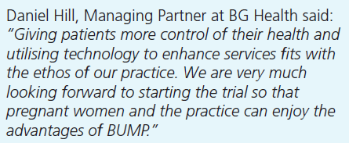
16
WOMEN CAN SELF-REFER FOR MATERNITY CARE VIA THE SINGLE POINT OF ACCESS (SPA) PORTAL
Early positive feedback received:
Next Steps for GP Practice:
Please contact project.bump@nhs.net with your contact details, and a member of the team will be in touch to assist to setup a intro meeting.
Information for GP Practice training and patient communication materials have been developed to start using SPA and will be discussed/ shared at the intro meeting.
Naila Ahmed, Practice Manager Khattak Memorial Surgery said:
We are very excited to pilot the project where referrals can be made by patients too. This will enable them to progress their individual care plans without the need to contact the practice. I am sure this was be a very efficient Programme.

